Slide 1
capstone
Trails Team

Slide 2
html, css, typescript
Frontend - Angular
API #1: Get image
imagegroupid
images[] : array of 3
species
animalcount
API #2: Submit Annotation
imagegroupid
species
animalcount
images
2 apis
S3 public bucket - images
API Server - Flask
python, db calls, model calls
DB
{
"imagegroupid" : "333",
"images" : [
https://panoptes-uploads.zooniverse.org/subject_location/60b9fcfa-20c0-45db-823a-4ce78ea1d740.jpeg,
https://panoptes-uploads.zooniverse.org/subject_location/ed1c603b-c741-44ad-ae11-3cdf404a3fb5.jpeg,
https://panoptes-uploads.zooniverse.org/subject_location/4804d5e2-3a2e-4ce6-b7c5-cc9397bb4a59.jpeg
],
”species" : "bobcat"
"animalcount" : 4,
}

Slide 3
DB
event_images
event_id: primary key
image_group_id: alphanumeric
image_url_1: alphanumeric (s3 bucket)
image_url_2: alphanumeric (s3 bucket)
image_url_3: alphanumeric (s3 bucket)
species_name: alphanumeric
count: numeric
blank_image: boolean
load_date: datetime (+ who columns)
event_annotations
1 : many
event_annotation_id: primary key
event_id: foreign key
image_group_id: alphanumeric
species_name: alphanumeric
count: numeric
blank_image: boolean
annotation_date: datetime
userid: alphanumeric (+ who columns)
Image_id: 1
Image_event_id: 32243
Image_url_1: http://…amazons3/32243_0.jpeg
Image_url_2: http://…amazons3/32243_1.jpeg
Image_url_3: http://…amazons3/32243_2.jpeg
Species: deer
Count: 2
….

Slide 4
html, css, typescript
Frontend - Angular
images
2 apis
S3 public bucket - images
API Server - Flask
python, db calls, model calls
DB

Slide 5
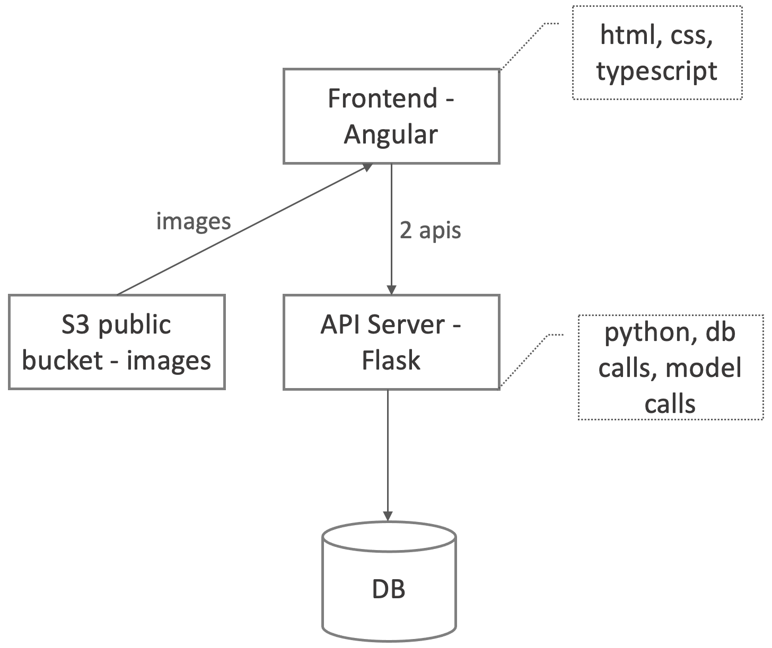
What gets measured,
gets managed

Slide 6


YOLOv5 inference
script
ensemble
script
efficientnet inference
script
DB
write
results
read
megadetector inference
script
GET
api
write
POST
api
angular single
page app
backend

Slide 7

YOLOv5 inference
script
ensemble
script
efficientnet inference
script
DB
write
results
read
megadetector inference
script
GET
api
write
POST
api
angular single
page app
partially completed
backend

Slide 8
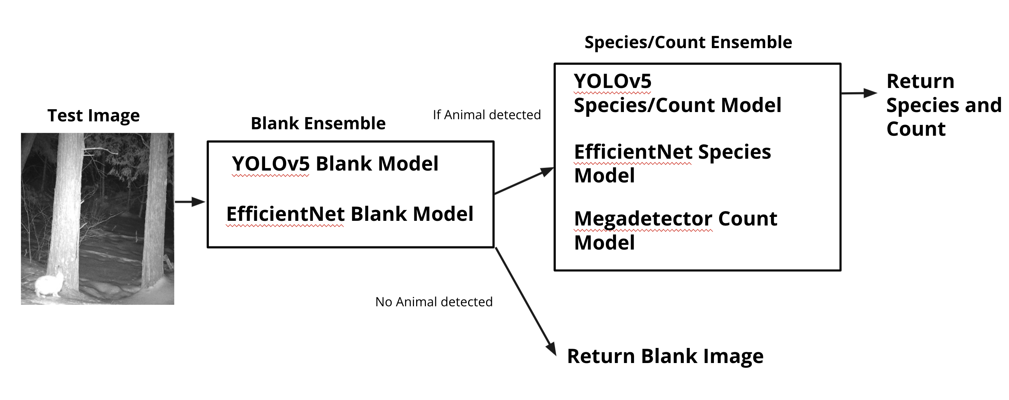

Slide 9
table:
event_annotations
3
YOLOv5 inference
script (blank)
model_id = 1
table:
model_outputs
1
efficientnet inference
script (blank)
ensemble
script
model_id = 2
table:
event_images
2
model_id = 3
YOLOv5 inference
script (species)
efficientnet inference
script (species)
write
results
model_id = 4
table:
ground_truth
4
megadetector inference
script (species)
Draft algorithm
model_id = 5
n
Database tables
partially completed

Slide 10
SSWI000000020163117A
SSWI000000020163117B
SSWI000000020163117C

Slide 12
event_images
event_annotations
event_id: primary key
image_group_id: alphanumeric
image_url_1: alphanumeric (s3 bucket)
image_url_2: alphanumeric (s3 bucket)
image_url_3: alphanumeric (s3 bucket)
species_name: alphanumeric
count: numeric
blank_image: boolean
load_date: datetime (+ who columns)
event_annotation_id: primary key
event_id: foreign key
image_group_id: alphanumeric
species_name: alphanumeric
count: numeric
blank_image: boolean
annotation_date: datetime
userid: alphanumeric (+ who columns)
1 : many

Slide 13
Table: Model_Output
model_ouput_id | int
model_id | int
image_group_id | alphanumeric
image_id_1 | alphanumeric
image_id_1_species_name | alphanumeric
Image_id_1_conf | string
image_id_1_count | int
image_id_1_blank | boolean
image_id_1_detectable | boolean
image_id_1_bbox | alphanumeric
image_id_2 | alphanumeric
image_id_2_species_name | alphanumeric
Image_id_2_conf | string
image_id_2_count | int
image_id_2_blank | boolean
image_id_2_detectable | boolean
image_id_2_bbox | alphanumeric
image_id_3 | alphanumeric
image_id_3_species_name | alphanumeric
Image_id_3_conf | string
image_id_3_count | int
image_id_3_blank | boolean
image_id_3_detectable | boolean
image_id_3_bbox | alphanumeric
load_date | datetime
detectable -> image is blur or animal too close to camera

Slide 14


YOLOv5 inference
script
ensemble
script
efficientnet inference
script
DB
write
results
read
megadetector inference
script
GET
api
write
POST
api
angular single
page app
backend

Slide 15
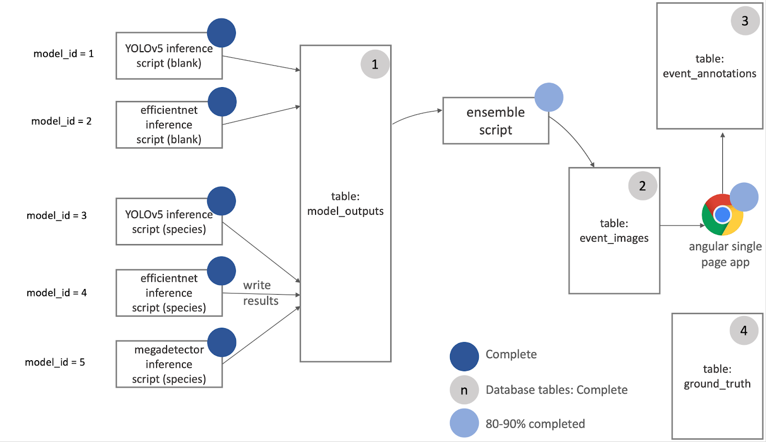
POST
GET

